Slide 1
Algorithm Complexity and Data Structures Efficiency
Overview of Data Structures and Basic Algorithms. Computational Complexity.

Slide 2
Table of Contents
Algorithms Complexity and Asymptotic Notation
Time and Memory Complexity
Mean, Average and Worst Case
Fundamental Data Structures – Comparison Arrays vs. Lists vs. Trees vs. Hash-Tables
Choosing Proper Data Structure

Slide 3
Why Data Structures are Important?
Data structures and algorithms are the foundation of computer programming
Algorithmic thinking, problem solving and data structures are vital for software engineers
All .NET developers should know when to use T[], LinkedList, List, Stack, Queue, Dictionary, HashSet, SortedDictionary and SortedSet
Computational complexity is important for algorithm design and efficient programming

Slide 4
Algorithm Complexity
Asymptotic Notation

Slide 5
Algorithm Analysis
Why we should analyze algorithms?
Predict the resources the algorithm requires
Computational time (CPU consumption)
Memory space (RAM consumption)
Communication bandwidth consumption
The running time of an algorithm is:
The total number of primitive operations executed (machine independent steps)
Also known as algorithm complexity

Slide 6
Algorithmic Complexity
What to measure?
CPU Time
Memory
Number of steps
Number of particular operations
Number of disk operations
Number of network packets
Asymptotic complexity

Slide 7
Time Complexity
Worst-case
An upper bound on the running time for any input of given size
Average-case
Assume all inputs of a given size are equally likely
Best-case
The lower bound on the running time (the optimal case)

Slide 8
Time Complexity – Example
Sequential search in a list of size n
Worst-case:
n comparisons
Best-case:
1 comparison
Average-case:
n/2 comparisons
The algorithm runs in linear time
Linear number of operations

Slide 9
Algorithms Complexity
Algorithm complexity is a rough estimation of the number of steps performed by given computation depending on the size of the input data
Measured through asymptotic notation
O(g) where g is a function of the input data size
Examples:
Linear complexity O(n) – all elements are processed once (or constant number of times)
Quadratic complexity O(n²) – each of the elements is processed n times

Slide 10
Asymptotic Notation: Definition
Asymptotic upper bound
O-notation (Big O notation)
For given function g(n), we denote by O(g(n)) the set of functions that are different than g(n) by a constant O(g(n)) = {f(n): there exist positive constants c
and n₀ such that f(n) <= c*g(n) for all n >= n₀}
Examples:
3*n² + n/2 + 12 ∈ O(n²)
4*n*log₂(3*n+1) + 2*n-1 ∈ O(n * log n)

Slide 11
Typical Complexities
Complexity | Notation | Description
constant | O(1) | Constant number of operations, not depending on the input data size, e.g. n = 1 000 000 → 1-2 operations
logarithmic | O(log n) | Number of operations proportional of log2(n) where n is the size of the input data, e.g. n = 1 000 000 000 → 30 operations
linear | O(n) | Number of operations proportional to the input data size, e.g. n = 10 000 → 5 000 operations

Slide 12
Typical Complexities
Complexity | Notation | Description
quadratic | O(n²) | Number of operations proportional to the square of the size of the input data, e.g. n = 500 → 250 000 operations
cubic | O(n³) | Number of operations proportional to the cube of the size of the input data, e.g. n = 200 → 8 000 000 operations
exponential | O(2^{n}) O(k^{n}) O(n!) | Exponential number of operations, fast growing, e.g. n = 20 → 1 048 576 operations

Slide 13
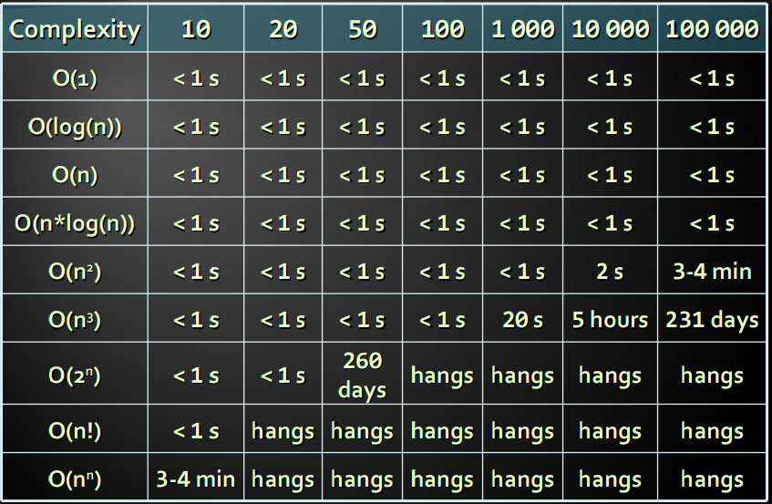
Time Complexity and Speed

Slide 14
Time and Memory Complexity
Complexity can be expressed as formula on multiple variables, e.g.
Algorithm filling a matrix of size [n x m] with the natural numbers 1, 2, … will run in O(n*m)
A traversal of graph with n vertices and m edges will run in O(n + m)
Memory consumption should also be considered, for example:
Running time O(n) & memory requirement O(n²)
n = 50 000 → OutOfMemoryException

Slide 15
The Hidden Constant
Sometimes a linear algorithm could be slower than quadratic algorithm
The hidden constant could be significant
Example:
Algorithm A makes: 100*n steps → O(n)
Algorithm B makes: n*n/2 steps → O(n²)
For n < 200 the algorithm B is faster
Real-world example:
Insertion sort is faster than quicksort for n <= 16

Slide 16
Polynomial Algorithms
A polynomial-time algorithm is one whose worst-case time complexity is bounded above by a polynomial function of its input size
W(n) ∈ O(p(n))
Examples:
Polynomial-time: log(n), n², 3n³+ 4n, 2 * n log(n)
Non polynomial-time: 2^{n}, 3^{n}, k^{n}, n!
Non-polynomial algorithms hang for large input data sets

Slide 17
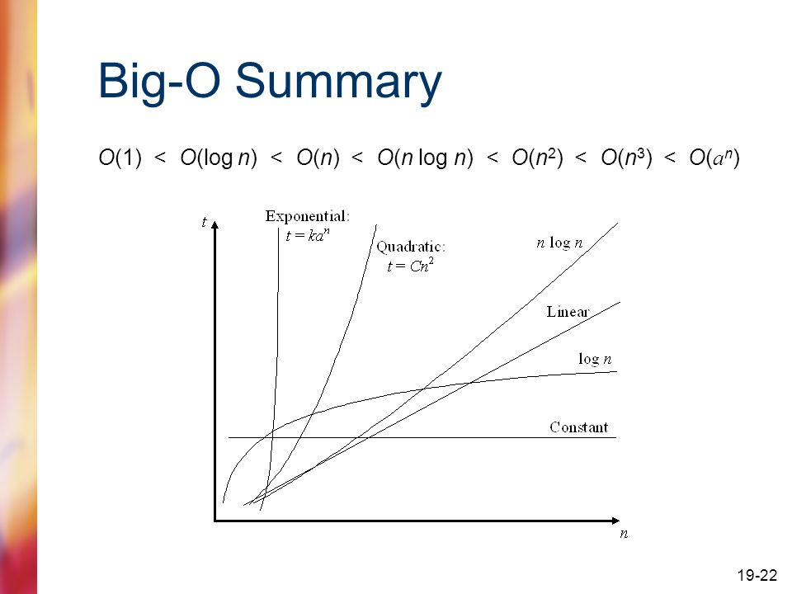

Slide 18
Analyzing Complexity of Algorithms
Examples ...

Slide 19
Complexity Examples
int FindMaxElement(int[] array)
{
int max = array[0];
for (int i = 0; i < array.Length; i++)
{
if (array[i] > max)
{
max = array[i];
}
}
return max;
}
Runs in O(n) where n is the size of the array
The number of elementary steps is ~n

Slide 20
Complexity Examples
long FindInversions(int[] array)
{
long inversions = 0;
for (int i = 0; i < array.Length; i++)
for (int j = i + 1; j < array.Length; i++)
if (array[i] > array[j])
inversions++;
return inversions;
}
Runs in O(n²) where n is the size of the array
The number of elementary steps is ~n*(n+1)/2

Slide 21
Complexity Examples
decimal Sum3(int n)
{
decimal sum = 0;
for (int a = 0; a < n; a++)
for (int b = 0; b < n; b++)
for (int c = 0; c < n; c++)
sum += a * b * c;
return sum;
}
Runs in cubic time O(n³)
The number of elementary steps is ~n³

Slide 22
Complexity Examples
long SumMN(int n, int m)
{
long sum = 0;
for (int x = 0; x < n; x++)
for (int y = 0; y < m; y++)
sum += x * y;
return sum;
}
Runs in quadratic time O(n*m)
The number of elementary steps is ~n*m

Slide 23
Complexity Examples
long SumMN(int n, int m)
{
long sum = 0;
for (int x = 0; x < n; x++)
for (int y = 0; y < m; y++)
if (x == y)
for (int i = 0; i < n; i++)
sum += i * x * y;
return sum;
}
Runs in quadratic time O(n*m)
The number of elementary steps is ~n*m + min(m,n)*n

Slide 24
Complexity Examples
decimal Calculation(int n)
{
decimal result = 0;
for (int i = 0; i < (1 << n); i++)
result += i;
return result;
}
Runs in exponential time O(2^{n})
The number of elementary steps is ~2^{n}

Slide 25
Complexity Examples
decimal Factorial(int n)
{
if (n == 0)
return 1;
else
return n * Factorial(n-1);
}
Runs in linear time O(n)
The number of elementary steps is ~n

Slide 26
Complexity Examples
decimal Fibonacci(int n)
{
if (n == 0)
return 1;
else if (n == 1)
return 1;
else
return Fibonacci(n-1) + Fibonacci(n-2);
}
Runs in exponential time O(2^{n})
The number of elementary steps is ~Fib(n+1) where Fib(k) is the k-th Fibonacci's number

Slide 27
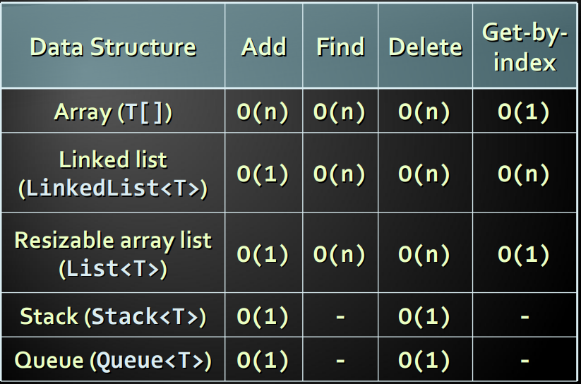
Comparing Data Structures

Slide 28
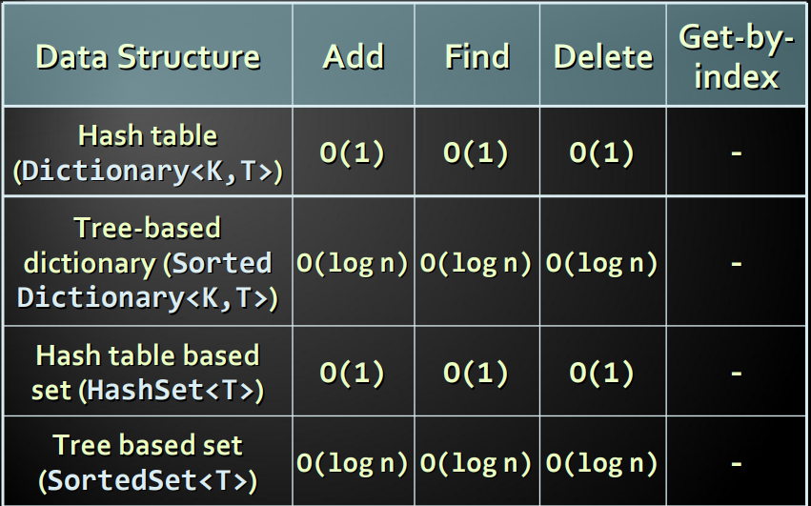
Comparing Data Structures

Slide 29
Choosing Data Structure
Arrays (T[])
Use when fixed number of elements should be processed by index
Resizable array lists (List)
Use when elements should be added and processed by index
Linked lists (LinkedList)
Use when elements should be added at the both sides of the list
Otherwise use resizable array list (List)

Slide 30
Choosing Data Structure (2)
Stacks (Stack<T>)
Use to implement LIFO (last-in-first-out) behavior
List<T> could also work well
Queues (Queue<T>)
Use to implement FIFO (first-in-first-out) behavior
LinkedList could also work well
Hash table based dictionary (Dictionary<K, T>)
Use when key-value pairs should be added fast and searched fast by key
Elements in a hash table have no particular order

Slide 31
Choosing Data Structure (3)
Balanced search tree based dictionary (SortedDictionary<K, T>)
Use when key-value pairs should be added fast, searched fast by key and enumerated sorted by key
Hash table based set (HashSet<T>)
Use to keep a group of unique values, to add and check belonging to the set fast
Elements are in no particular order
Search tree based set (SortedSet<T>)
Use to keep a group of ordered unique values

Slide 32
Summary
Algorithm complexity is rough estimation of the number of steps performed by given computation
Complexity can be logarithmic, linear, n log n, square, cubic, exponential, etc.
Allows to estimating the speed of given code before its execution
Different data structures have different efficiency on different operations
The fastest add / find / delete structure is the hash table – O(1) for all these operations

Slide 33
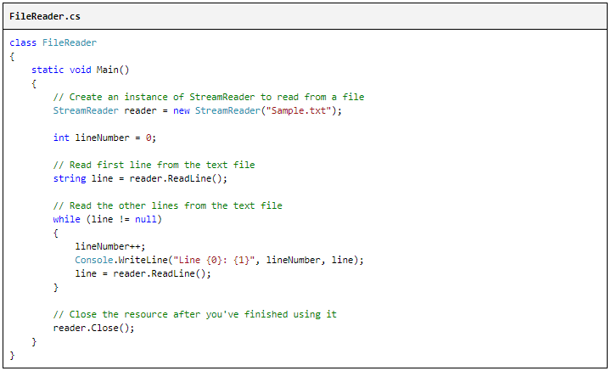
Working with text files

Slide 34
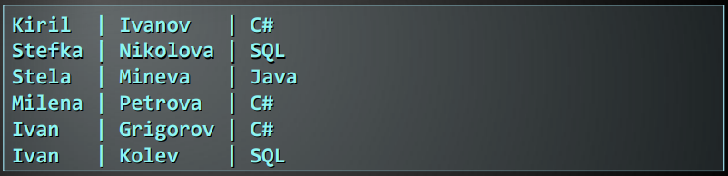
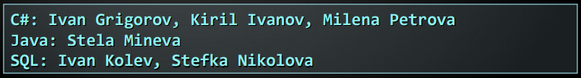
Exercise 1
A text file students.txt holds information about students and their courses in the following format:
Using SortedDictionary<K,T> print the courses in alphabetical order and for each of them prints the students ordered by family and then by name:
http://www.introprogramming.info/english-intro-csharp-book/read-online/chapter-19-data-structures-and-algorithm-complexity/#Sorting_Students

Slide 35
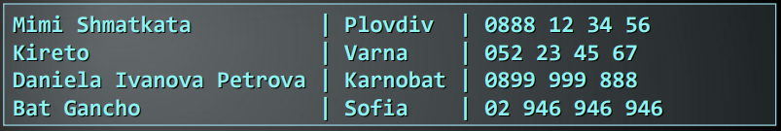
Exercise 2
A text file phones.txt holds information about people, their town and phone number:
Duplicates can occur in people names, towns and phone numbers. Write a program to execute a sequence of commands from a file commands.txt:
find(name) – display all matching records by given name (first, middle, last or nickname)
find(name, town) – display all matching records by given name and town

Slide 36
Exercise 3
A large trade company has millions of articles, each described by barcode, vendor, title and price. Implement a data structure to store them that allows fast retrieval of all articles in given price range [x…y].
Hint: use OrderedMultiDictionary from Wintellect's Power Collections for .NET.

Slide 37
Exercise 4
Implement a data structure PriorityQueue that provides a fast way to execute the following operations:
add element;
extract the smallest element.

Slide 38
Exercise 5
Implement a class BigDictionary<K1,K2,T> that allows adding triples {key1, key2, value} and fast search by key1, key2 or by both key1 and key2. Note: multiple values can be stored for given key.

